Slide 1
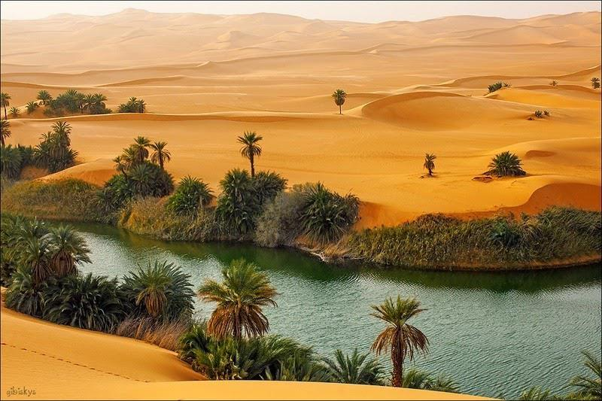
yes…HERE! Isaiah 35

Slide 2
Be strong, do not fear;
your God will come,
he will come with vengeance;
with divine retribution
he will come to save you.
Isaiah 35.4

Slide 3
Then will the eyes of the blind be opened
and the ears of the deaf unstopped. Then the lame will leap like a deer, and the mute tongue shout for joy.
.5-6

Slide 4
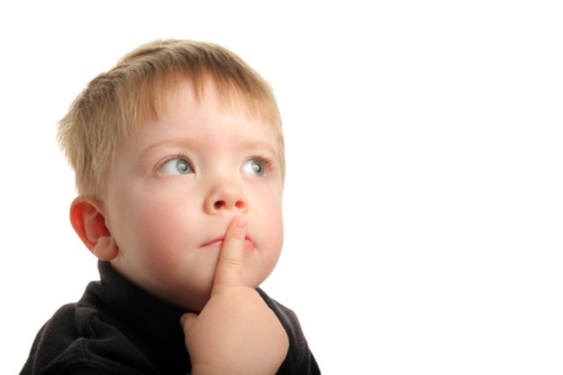
Why?
When?
Who?
How?

Slide 5
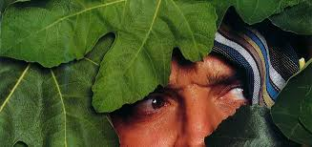
I
WAS
AFRAID
…so I
HID

Slide 6
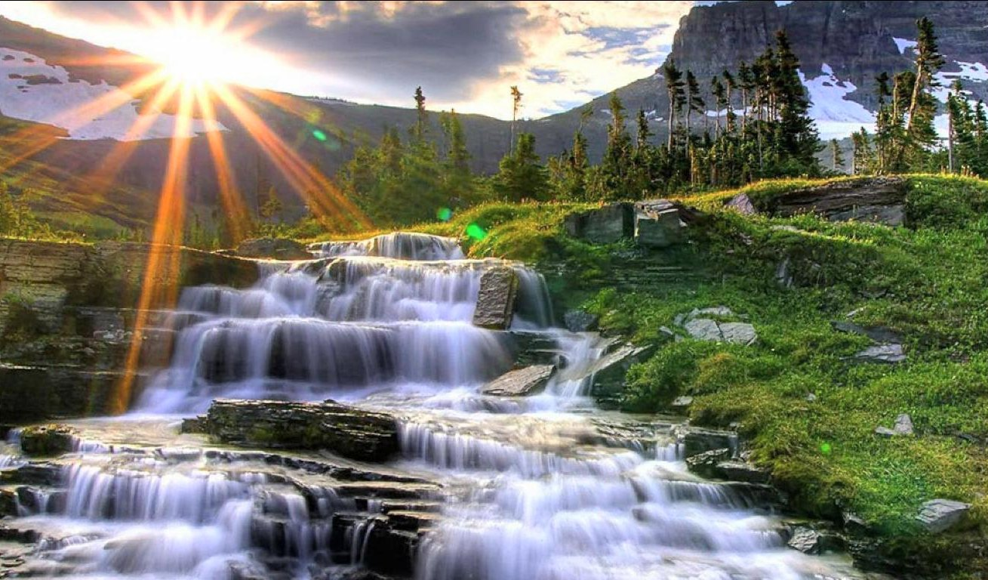
…BUT, God promised— EZEKIEL 47.1-12

Slide 7
This water flows there and makes the salt water fresh; so where the river flows everything will live. Ezekiel 47:9
Fruit trees of all kinds will grow…the water from the sanctuary flows to them. Their fruit will serve for food and their leaves for healing. Ezekiel 47:12

Slide 8
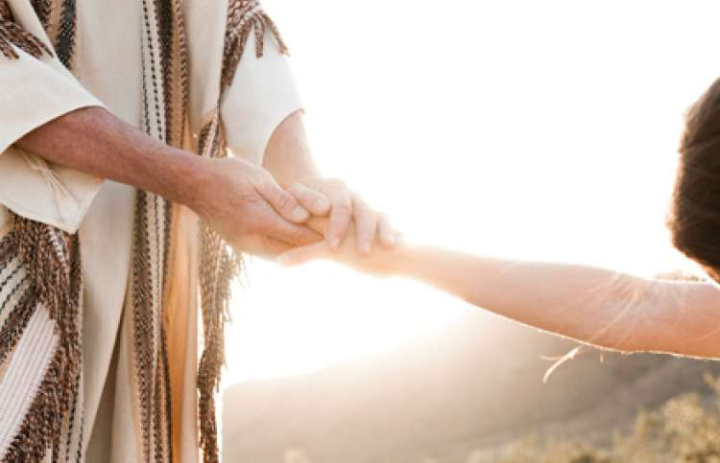
Jesus:
If anyone
comes…
John 7

Slide 9

THEN!

Slide 10
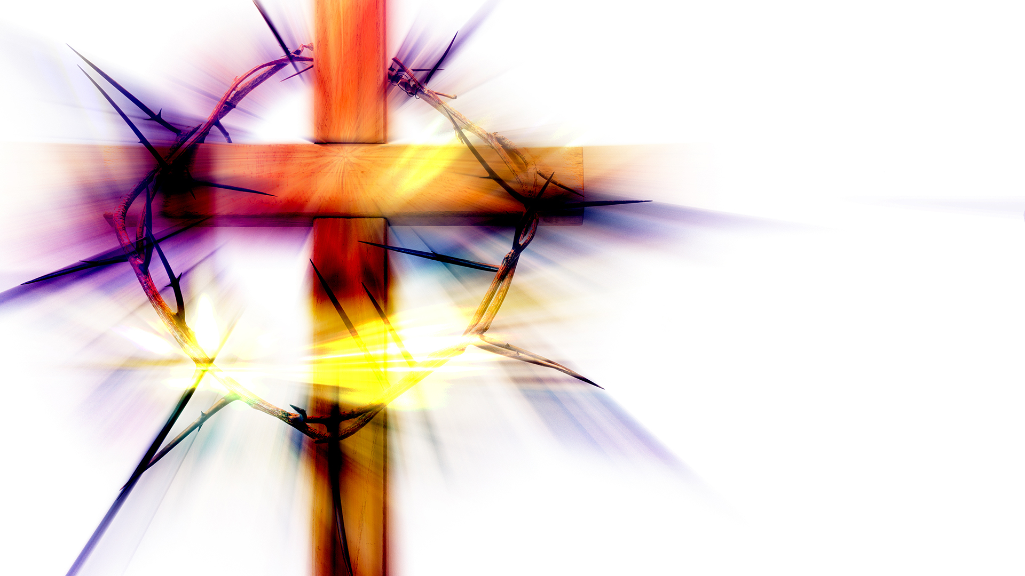
THEN!

Slide 11
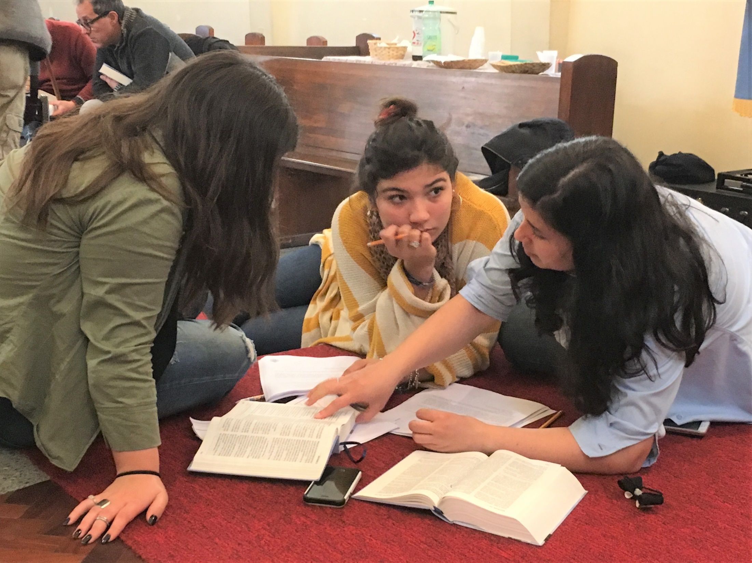
NOW!

Slide 12
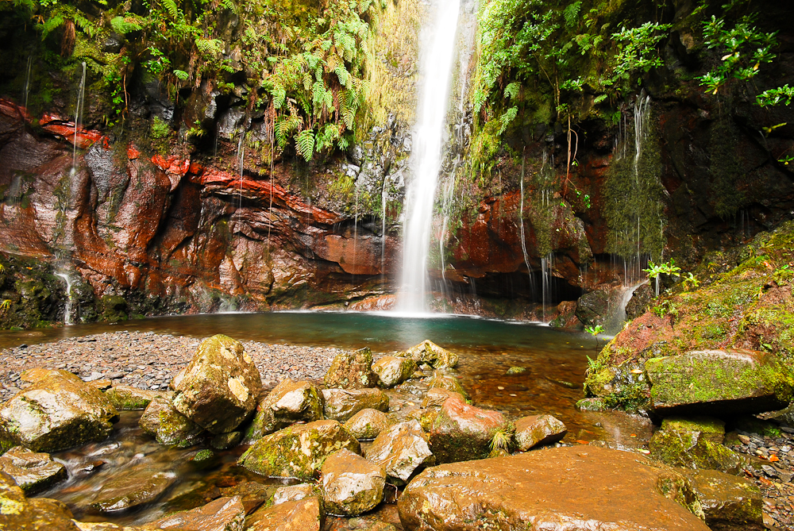
Rev. 22
I am coming soon!

